Slide 1
Intro to GitHub

Slide 2
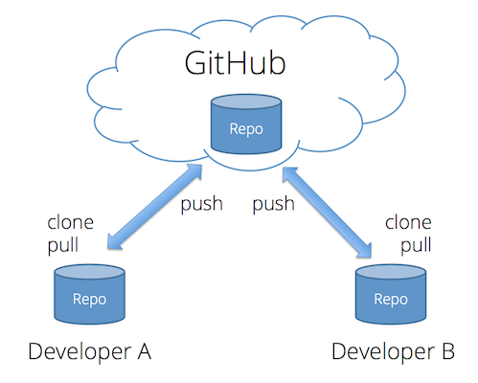
https://faculty.washington.edu/dlsinfo/tutorials/essential-git/

Slide 3
Portfolios
During the week we will code a lot.
We're going to set you up with a portfolio website of you very own to showcase your work.
Throughout the week you will send content to the site to practice and show off your progress.

Slide 4
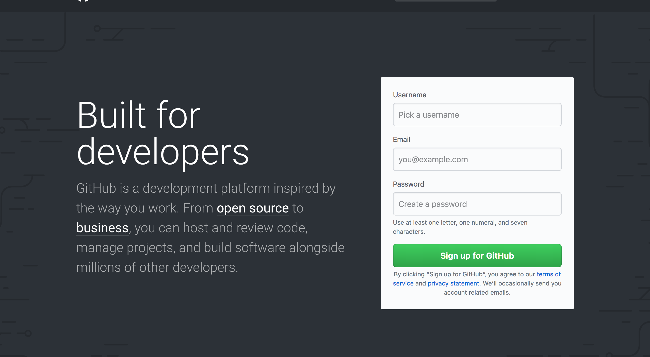
github.com
Notes:
step one – sign up

Slide 5
Verify
Second step is to verify your account – you should have gotten an email to the account you linked to.
Notes:
Sign up for a GitHub account at https://github.com/join. You want your username to be descriptive of your digital identity. This will become your domain, so be mindful of that. For example, my GitHub username is walshbr.

Slide 6
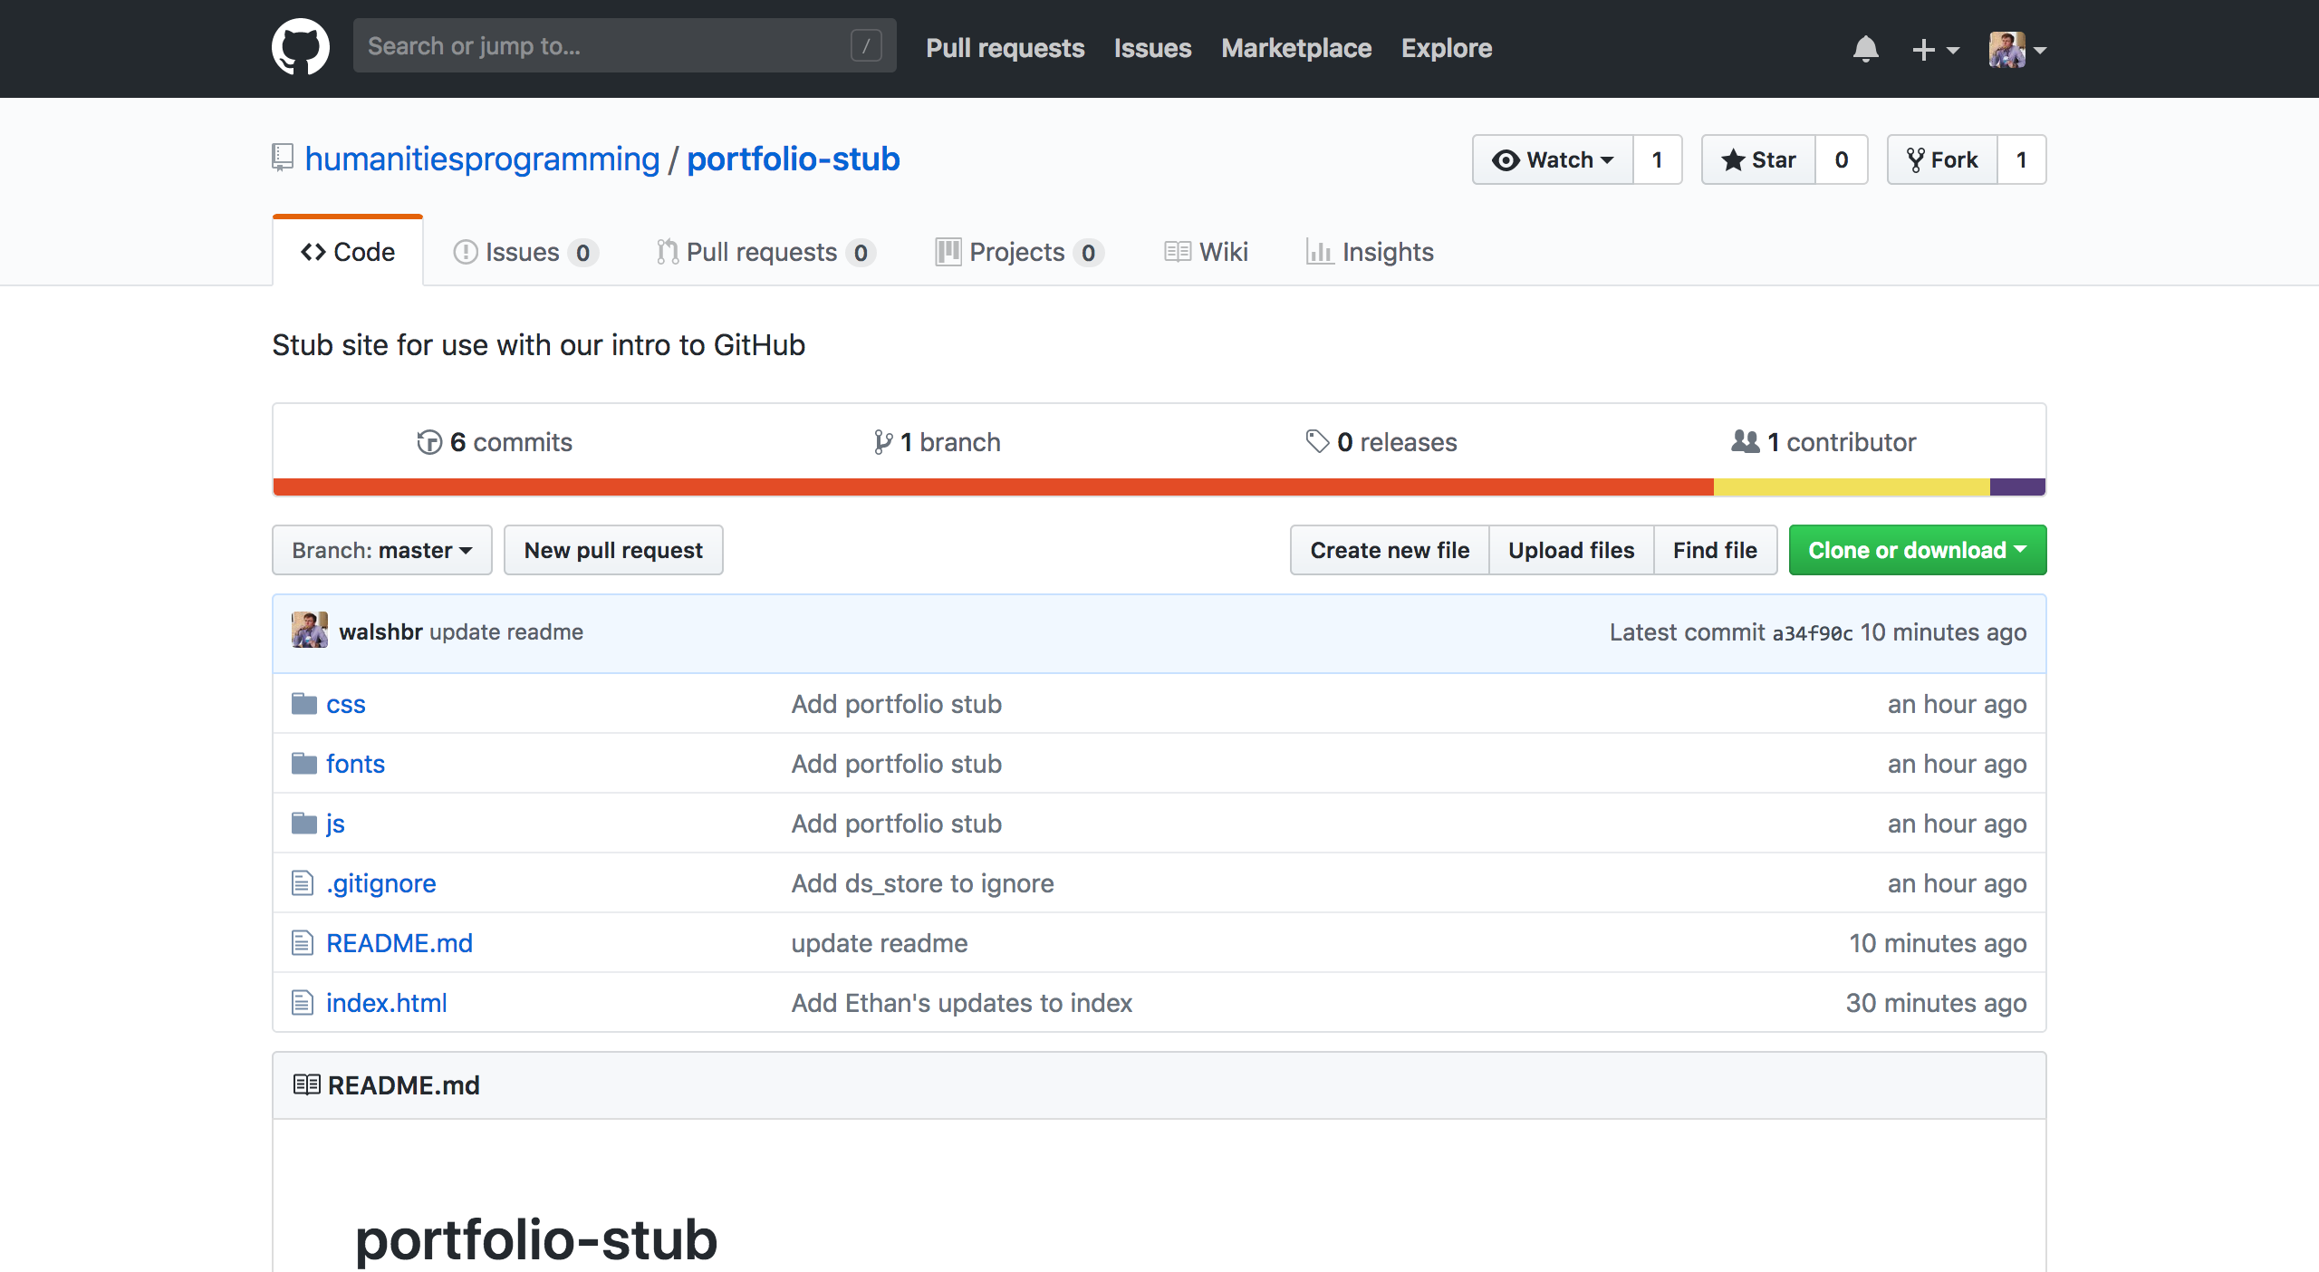
http://bit.ly/2spygd4
Notes:
visit this url - https://github.com/humanitiesprogramming/portfolio-stub

Slide 7

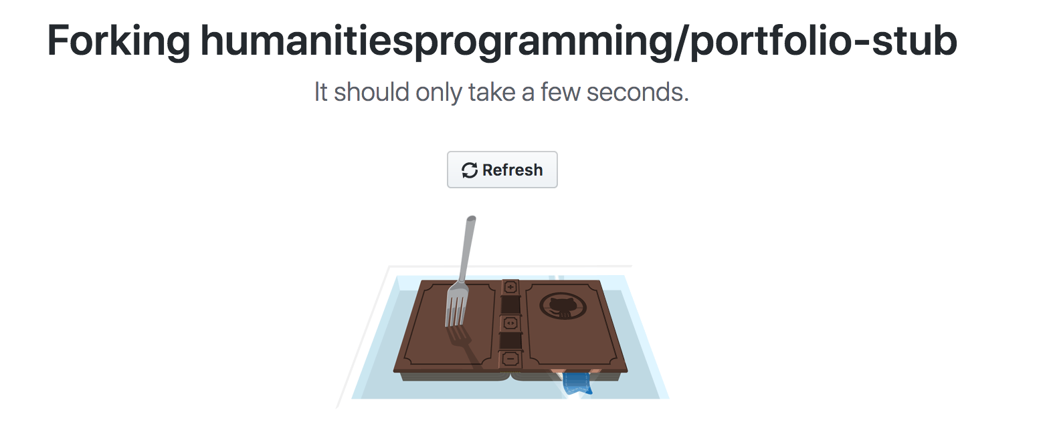
Fork
Notes:
Click the fork button in the top right to copy the stub portfolio to your GitHub account. You'll be redirected to a new page after you're done.

Slide 8
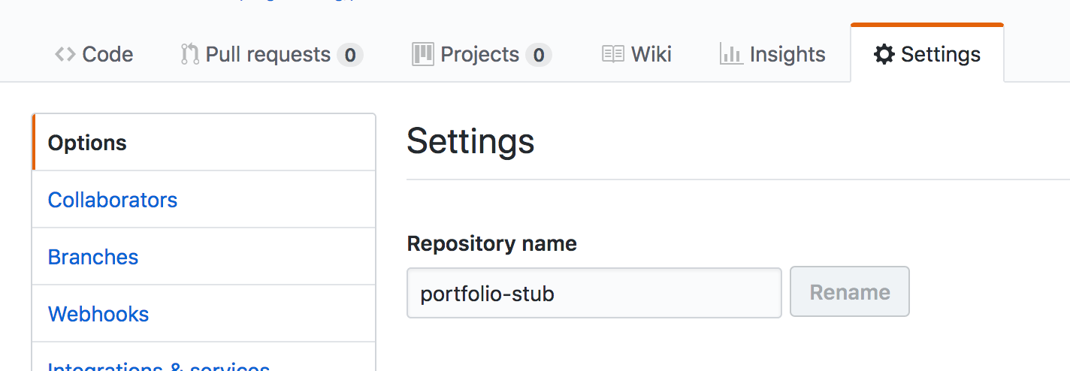
Rename Repository
Notes:
Click the gear icon to access the "settings" for your new repository. In there, search for "repository name" and change it from "portfolio-stub" to be .github.io, where is your unique username. I.e., if your username is reedeth on GitHub your repository name would be reedeth.github.io. Click rename.

Slide 9
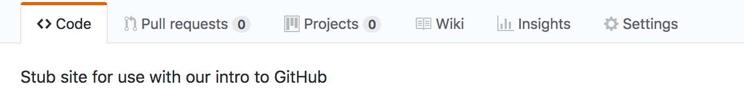
Notes:
Click back to the "code" tab.
Look for the button that says "clone or download." Click it. Copy the link in it to your clipboard by either highlighting and copying or clicking the keyboard.

Slide 10
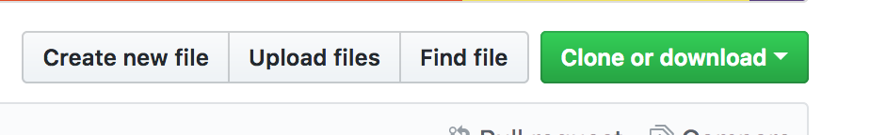
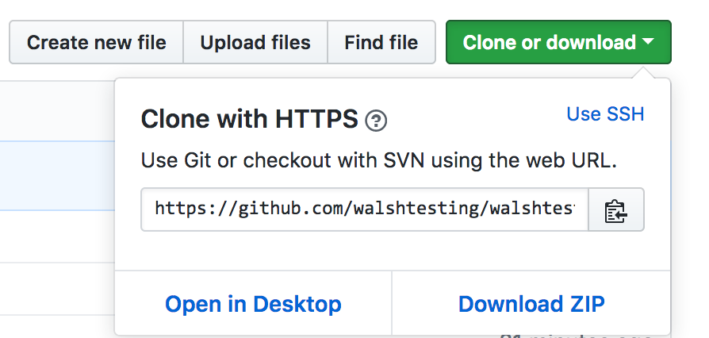
Notes:
Look for the button that says "clone or download." Click it. Copy the link in it to your clipboard by either highlighting and copying or clicking the keyboard.
MAKE SURE YOU'RE CLONING WITH HTTPS

Slide 11
Getting a Local Copy
$ cd ~/Desktop
$ git clone THE_SLUG_YOU_COPIED
$ cd YOUR_REPO_NAME
$ atom index.html

Slide 12
Make a Change!
<h1>A most excellent HILT portfolio</h1>
<h1>Brandon's HILT portfolio</h1>
Notes:
Line 38
Note the places where you can upload a link and give a description of your exercises.

Slide 13
Push It
$ git add .
$ git commit -m "The change I made"
$ git push

Slide 14
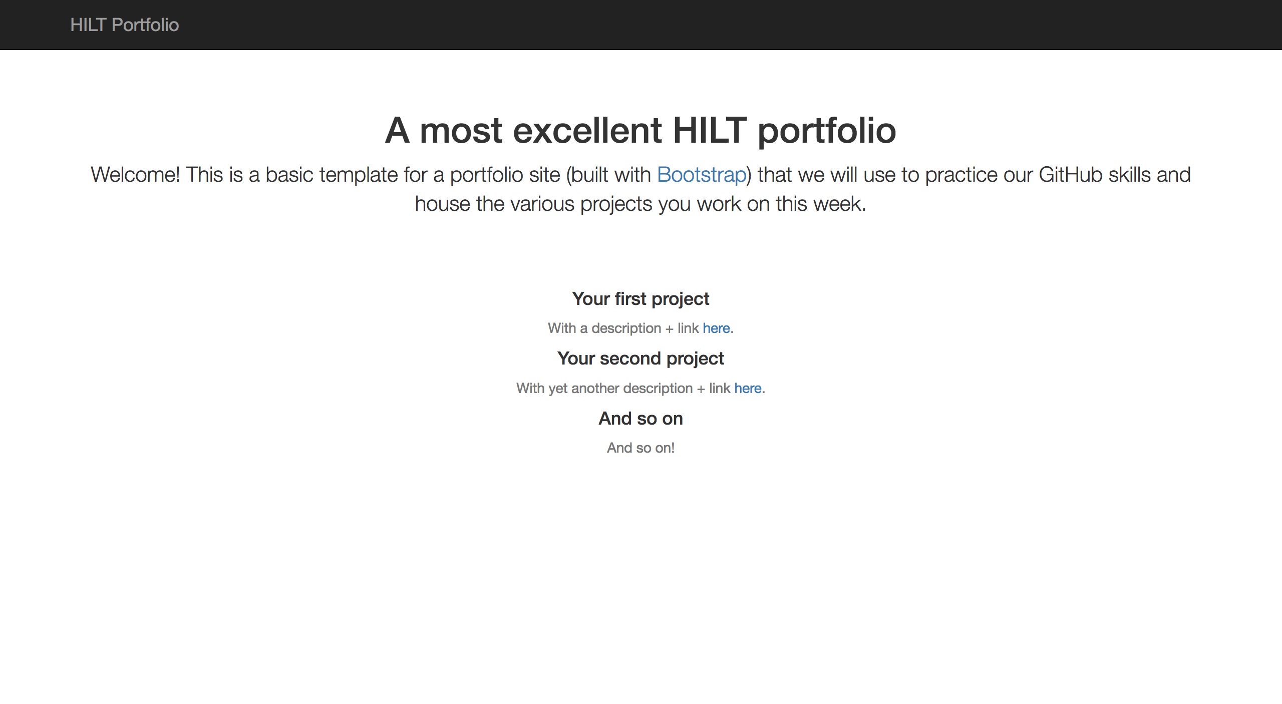
Voila!
Visit <username>.github.io in the browser
You've got a portfolio!

